Slide 1
Green growth frameworks

Slide 2
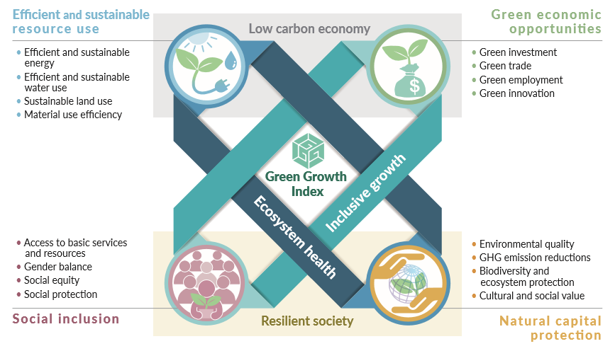
Green Growth Index
Useful definitions:
In every composite index is a framework to explain what it is trying to measure.
A framework provides a concept on interlinkages between its components (i.e., dimensions), and ultimately the indicators.
Green Growth Index measures country performance in achieving sustainability targets incl. Sustainable Development Goals (SDGs), Paris Climate Agreement, and Aichi Biodiversity Targets for four green growth dimensions.

Slide 3
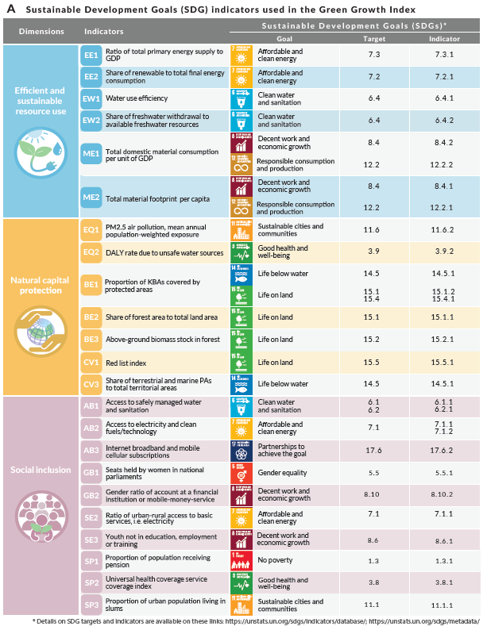
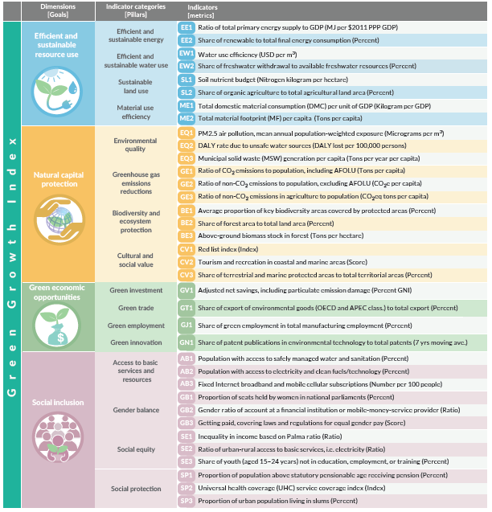
Indicator Framework
Useful definitions:
26 SDGs
64%

Slide 4
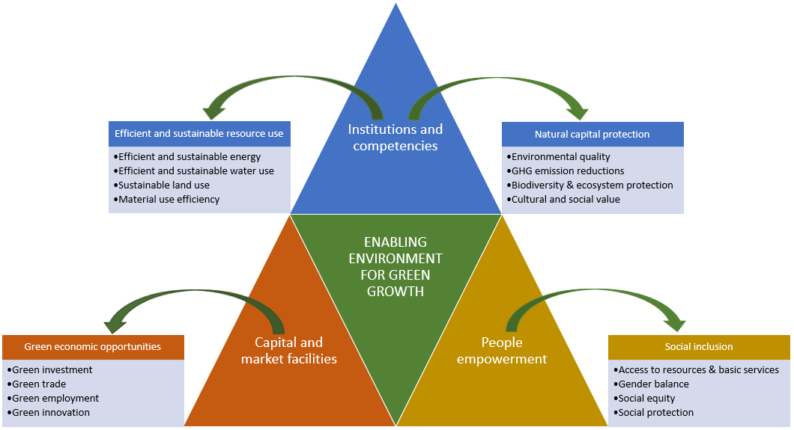
Enabling Environment
Useful definitions:
Enabling environment is defined as a set of interrelated conditions, i.e., legal, fiscal, regulatory, informational, political, and societal, that impact the capacity of actors and organizations to support the country’s transition to green growth.

Slide 5
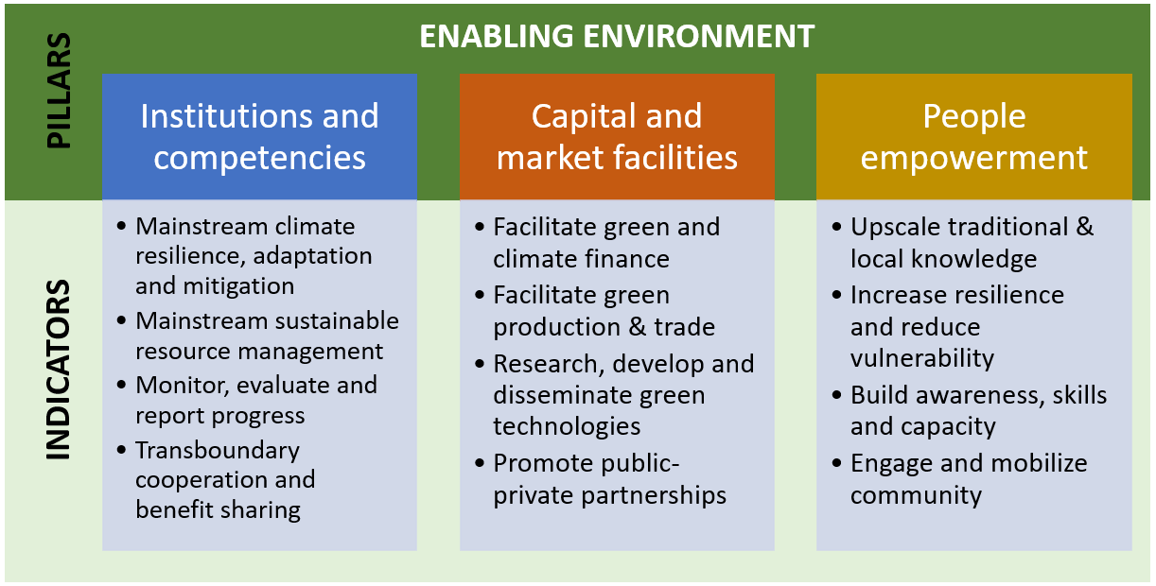
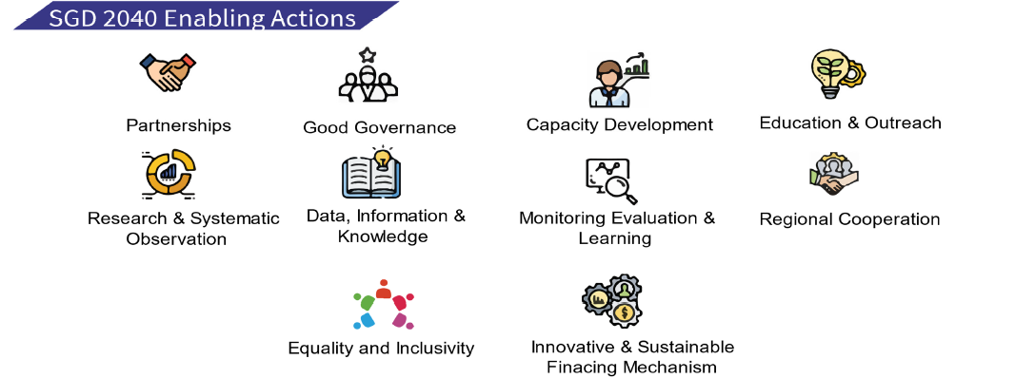
Enabling Environment
Useful definitions:
Generally, SGD enabling actions can be aligned to these pillars:
institutions and competencies – good governance, regional cooperation, monitoring evaluation and learning;
capital and market facilities – innovative and sustainable financing mechanism, partnerships, research and systematic observations; and
people empowerment – equality and inclusivity, education and outreach, capacity development.
Note: Data, information, and knowledge are enabling actions can cut across three pillars of enabling environment and assignment to the pillars depend on the nature and purpose of the indicators.

Slide 6
Analytical approaches

Slide 7
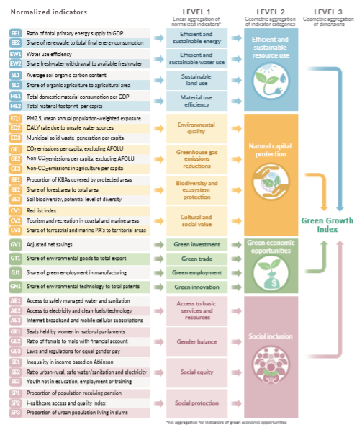
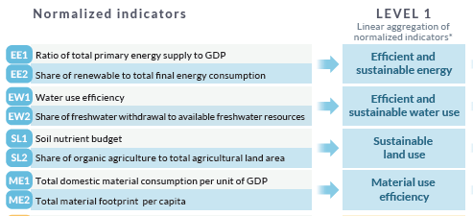
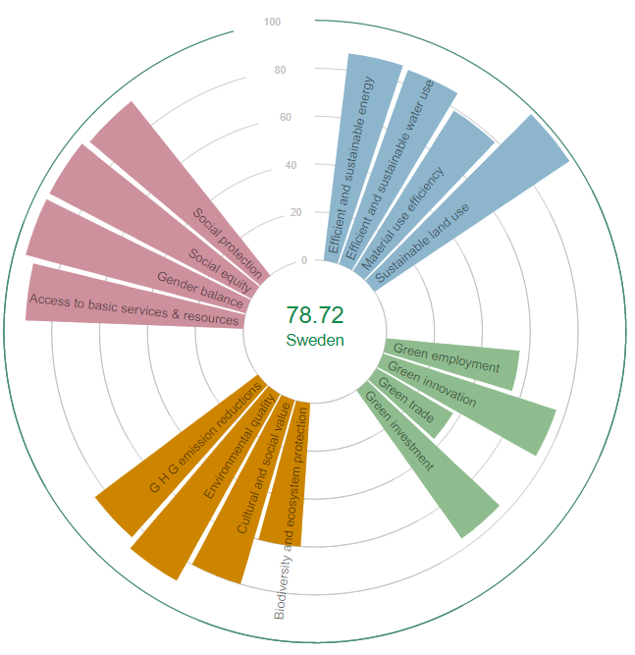
GGindex: Green Growth Performance
Useful definitions:
Normalization transform the units of the indicators into the same scale, i.e., 1-100.
Normalization integrates sustainability targets – also referred to as benchmarking,
So, a score of 100 means target is achieved.

Slide 8
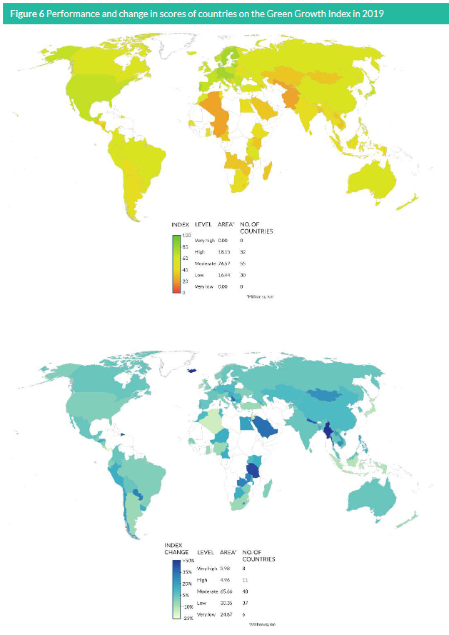
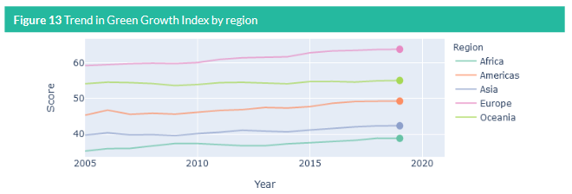
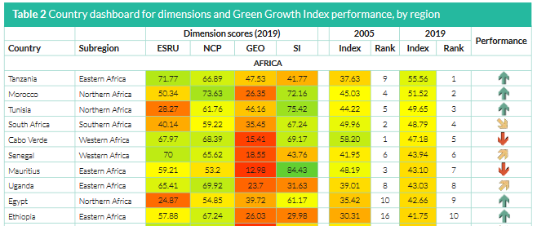
GGindex: Green Growth Performance
Useful definitions:

Slide 9
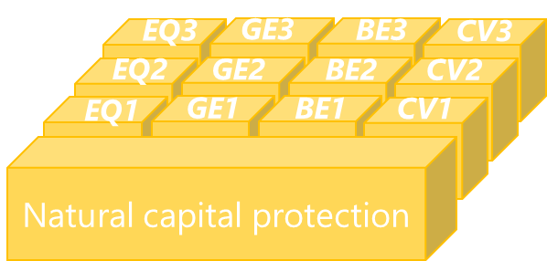
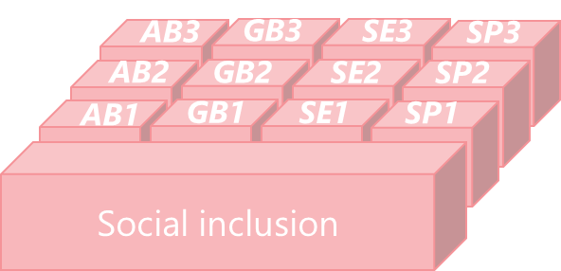
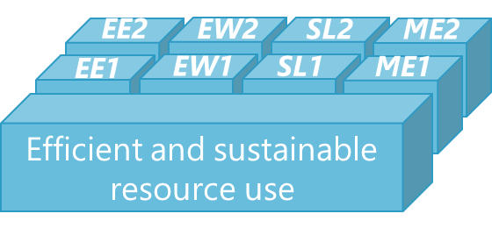
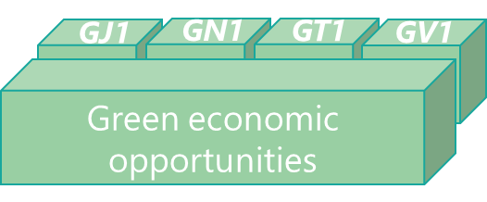
GGsim: Co-benefits assessment
Model1
Climate action
or Green Deal
EQ1
Var
Var
Par
Model2
Model2
EQ1
Var
Var
Par
EQ1
Var
Var
Par
Model3
Model3
EQ1
Var
Var
Par
EQ2
Var
Var
Par
EQ2
Var
Var
Par
EQ1
Var
Var
Par
Model4
EQ3
Var
Var
EQ2
Var
Var
Par
EQ1
Var
Var
Par
EQ3
Var
Var
EQ3
EQ2
Var
Var
Par
EQ2
Var
Var
Par
EQ3
Var
Var
EQ3
EQ4
Var
Var
Var
EQ2
Var
Var
Par
EQ3
Var
Var
EQ4
Var
Var
Var
EQ4
EQ4
Var
Var
Par
EQ5
Var
Var
Par
EQ4
EQ4
Var
Var
Par
EQ5
Var
Var
Par
EQ5
Var
Var
Par
EQ5
Var
Var
Par
EQ5
Var
Var
Par
EQ5
Var
Var
Par
Model1
Model1
Model3
Model4
Model2
Model4
Model2
Model4
Model1
Model3
Co-benefits
Co-benefits
Co-benefits
GREEN GROWTH INDEX

Slide 10
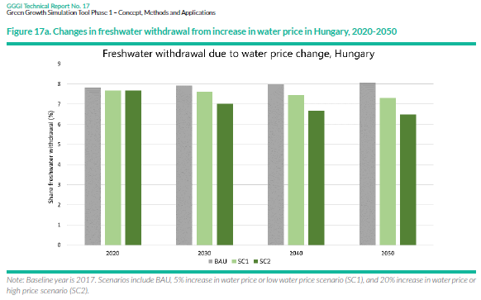
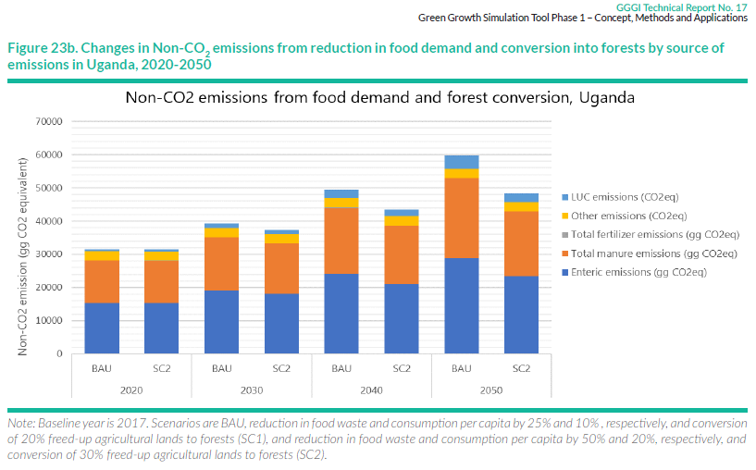
GGsim: Co-benefits assessment
Results from water models
Results from land use models

Slide 11
GGsim: Co-benefits assessment
Sector | Investment/Policy Measures | Relevant SDGs
Energy | Electricity generation (e.g., solar, wind, biofuels, waste-to-energy ) | Ratio of total primary energy supply to GDP (SDG 7.3.1) Municipal solid waste generation per capita (link to SDG 11.6.1)
 | Industry (e.g., energy efficiency in manufacturing, cement production) | Share of renewable to total final energy consumption (SDG 7.2.1) Share of freshwater withdrawal to available freshwater resources (SDG 6.4.2)
 | Transport (e.g., vehicle emission performance, electric vehicles, transport modes) | Share of renewable to total final energy consumption (SDG 7.2.1) PM2.5 air pollution (SDG 11.6.2)
 | Buildings/residential (e.g., efficient lights and appliances, solar) | Share of renewable to total final energy consumption (SDG 7.2.1) Population with access to electricity (SDG 6.1.1)
AFOLU | Irrigation system (e.g., solar pumps, rice management) | Ratio of total primary energy supply to GDP (SDG 7.3.1) Share of freshwater withdrawal to available freshwater resources (SDG 6.4.2)
 | Soil and water conservation (e.g., crop rotation, terracing, tillage, organic farming) | Soil nutrient budget (link to SDG 15.3.1) Water use efficiency (SDG 6.4.1)
 | Livestock (e.g., feed use, enteric fermentation, manure management,) | Soil nutrient budget (link to SDG 15.3.1) GHG emissions (link to SDG 13)
 | Forest (e.g., agro-forestry, reforestation) | Share of forest area to total land area (SDG 15.1.1) Above-ground biomass stock in forest (SDG 15.2. 1)
Water | Marine/coastal (e.g., mangroves, sustainable fishing) | Share of forest area to total land area (SDG 15.1.1)
 | Freshwater (e.g., wastewater treatment, desalination) | Share of freshwater withdrawal to available freshwater resources (SDG 6.4.2) Population with access to safely managed water and sanitation (SDG 6.1.1 and 6.2. 1)
Waste | Waste collection, recycling and composting | Municipal solid waste generation per capita (link to SDG 11.6.1) Share of organic agriculture to total agricultural land area (link to SDG 15.3.1)
 | Reduce material and food waste | Municipal solid waste generation per capita (link to SDG 11.6.1)

Slide 12
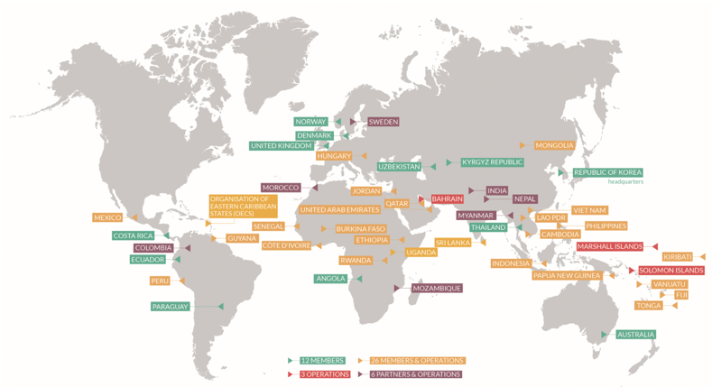
GGsim Applications – Country-level
Hungary Green Deal (Santa project): Commence in April
Senegal Green Recovery (funded by MAVA): Commence in April
Hungary LTS: Final approval and submission to EU and UNFCCC, creation of a knowledge product
Tonga LEDS (funded by NZ): Continue support and final submission before COP26
Ethiopia LEDS (funded by AFD): Commence in April
Burkina Faso LEDS (funded by AFD): Commence in April
Vanuatu LEDS: (to be funded by NZ): Project proposal submitted
Solomon Islands LEDS (to be funded by Pacific NDC hub): Preparatory phase
Cambodia LEDS: GGGI’s support on Waste sector pathways
Notes:
GGGI’s strong relationships with partner governments and in-country staff provide local economic, social, and environmental insights and create a long-term platform for stakeholder engagement, capacity building, and successful project implementation. In many of our in-country operations, GGGI works with National Designated Authorities (NDAs) and Direct Access Entities.
To demonstrate our work, Ethiopia’s Climate-Resilient Green Economy (CRGE) was developed and launched in 2011 in Durban, South Africa with the support of GGGI. Additionally, GGGI supported the development of Fiji’s LT-LEDS, which was approved by the Government in November 2018 and launched on December 13 at COP24 in Katowice, Poland. Currently, GGGI is supporting the Governments of Tonga and Hungary to develop their LT-LEDS.

Slide 13
GGPM Knowledge Products

Slide 14
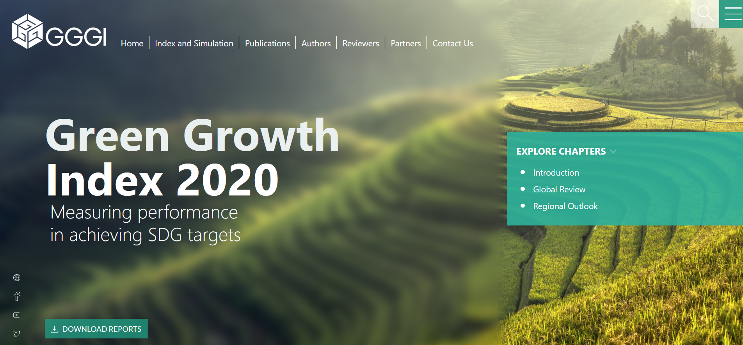
GGPM Knowledge Products
Green Growth Index Website https://greengrowthindex.gggi.org/
Useful definitions:

Slide 15
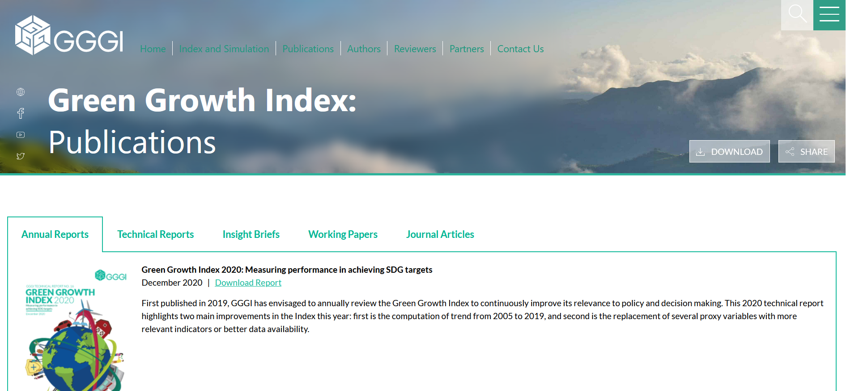
GGPM Knowledge Products
Green Growth Index Publications

Slide 16
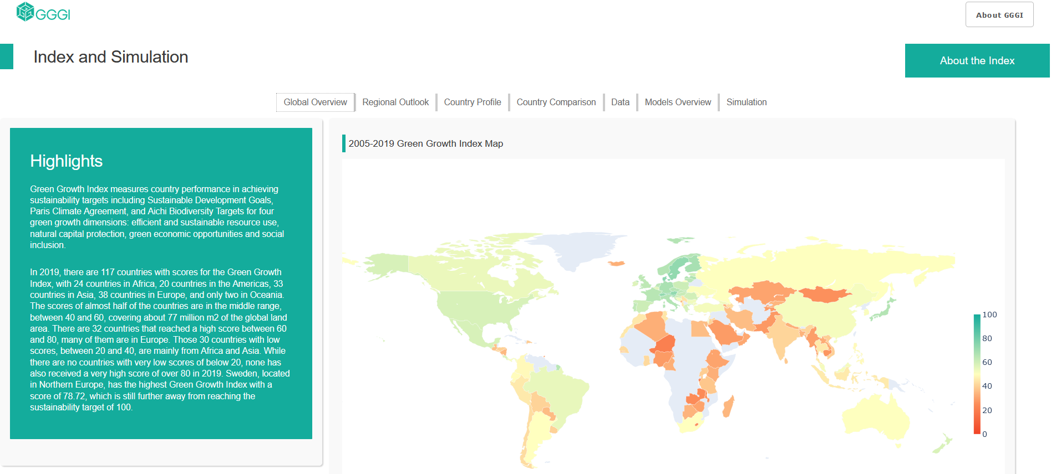
GGindex and GGsim Applications – Global
Useful definitions:
Green Growth Index
Evidence Library

